Slide 1
Bellabeat Case Study: Smart Device Usage Analysis
Product Focus: Leaf
Prepared by: Ruben -Andujo
Date: 1-29-2026

Slide 2
AGENDA
Introduction & Business Task
Data Source & Preparation
Key Findings
Insights Summary
Recommendations
Closing & Next Steps

Slide 3
Business Task
Objective: Analyze smart device usage data to uncover behavioral patterns and guide Bellabeat’s marketing strategy.
Context: Bellabeat aims to expand its presence in the global smart device market. Urška Sršen believes that fitness data can unlock new growth opportunities.
My Role: As a junior data analyst on the marketing analytics team, I was tasked with extracting insights from smart device data and presenting high-level findings to the Bellabeat executive team.

Slide 4
Data Source
Smart device usage data provided for the Bellabeat case study.
Includes daily activity metrics such as steps, calories, and activity intensity.

Slide 5
PREPARATION
Preparation
Merged Multiple CSVs into a unified dataset
Validated column structure and data integrity
Converted time stamps and added day-of-week
Exported modular .rds files for clean analysis in r studio
Tools Used:
R for data cleaning, transformation, and exploratory visuals
Tableau planned for executive-ready dashboards

Slide 6
KEY FINDINGS, ACTIVITY
Users show low overall movement Most daily step totals fall well below the commonly referenced 10,000‑step benchmark used in consumer fitness contexts.
2. Activity peaks mid‑week Wednesday consistently shows the highest step counts across the dataset.
3. Weekends show a noticeable drop Saturday and Sunday activity levels decline, suggesting reduced structured movement outside weekday routines.
4. High‑intensity activity is uncommon Most logged minutes fall into light or moderate intensity, with very few high‑intensity minutes recorded.

Slide 7
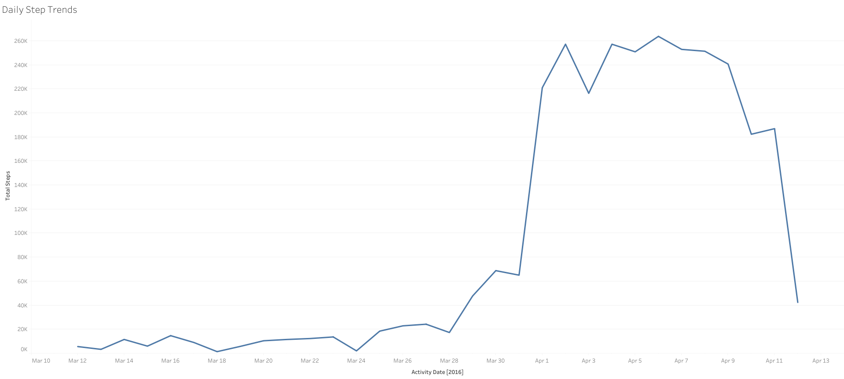
Daily Step Trends Daily step patterns show consistent activity with clear peaks and dips, giving us a baseline for overall movement habits. This sets the foundation for understanding how intensity and calorie burn develop across the week.

Slide 8
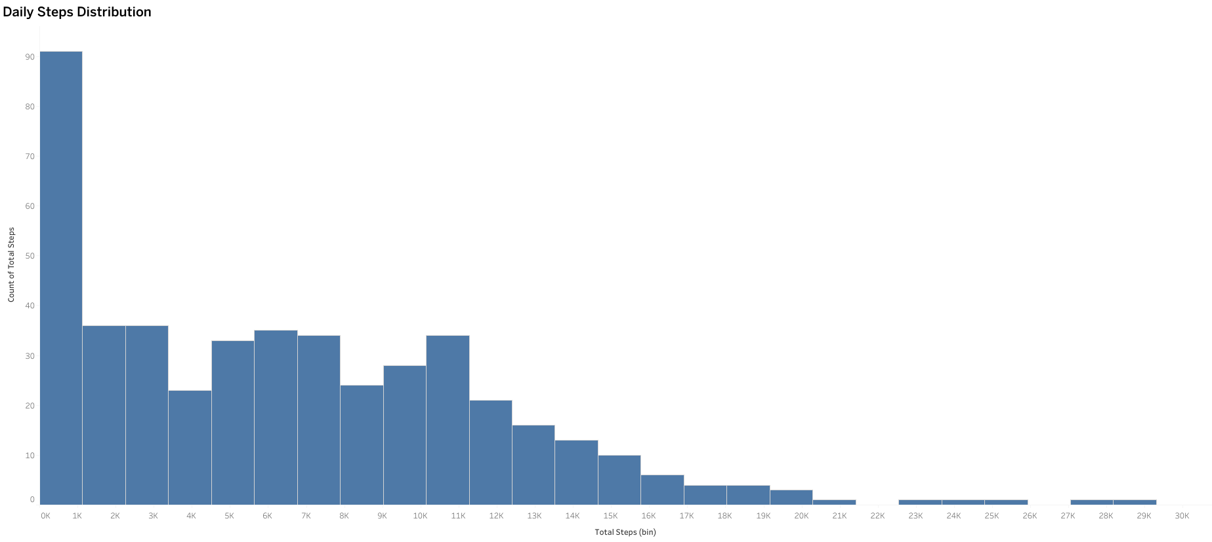
Daily Steps Distribution Step counts cluster around a consistent daily range, with occasional spikes. This reinforces the baseline and highlights variability that may signal changes in routine or motivation.

Slide 9
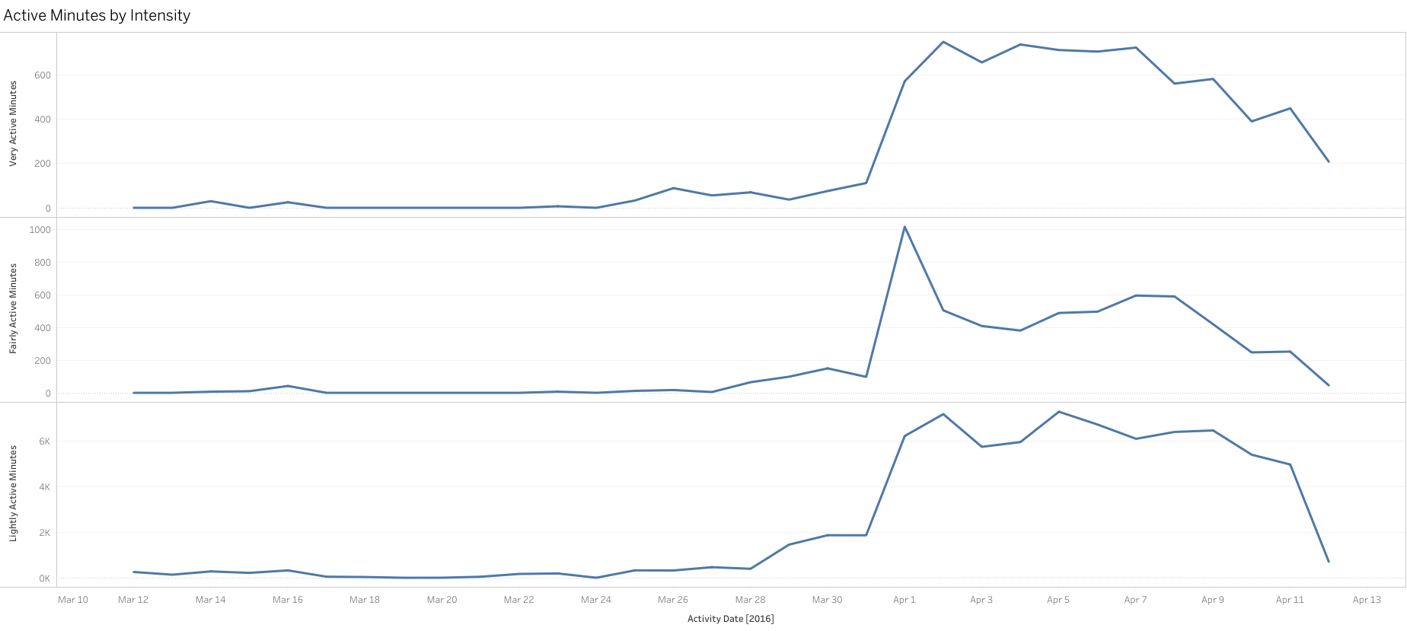
Active Minutes by Intensity Active minutes break cleanly across intensity levels, showing how effort is distributed throughout the day. This helps us understand where meaningful activity is actually happening.

Slide 10
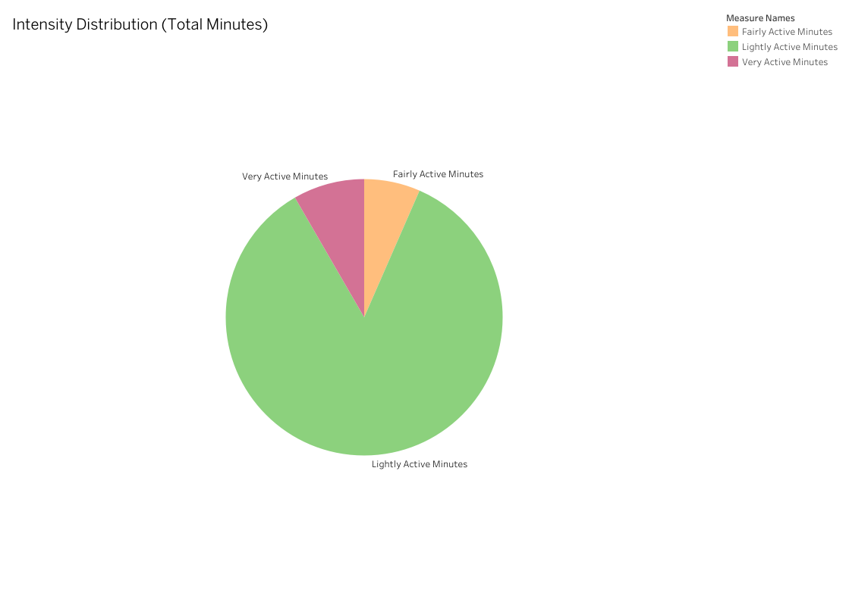
Intensity Distribution Total active minutes are concentrated in lower‑intensity zones, with smaller but meaningful contributions from higher‑intensity activity. This helps clarify where most effort is actually being spent.

Slide 11
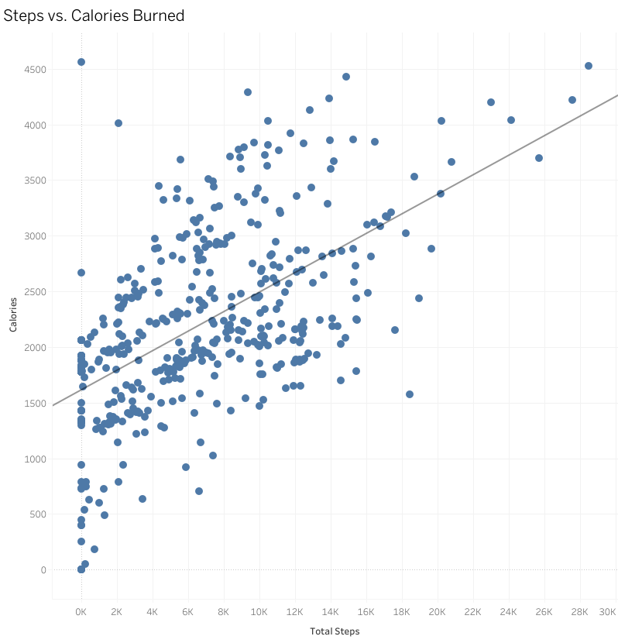
Steps vs Calories Higher step counts consistently align with higher calorie burn, showing a clear relationship between movement volume and energy output.

Slide 12
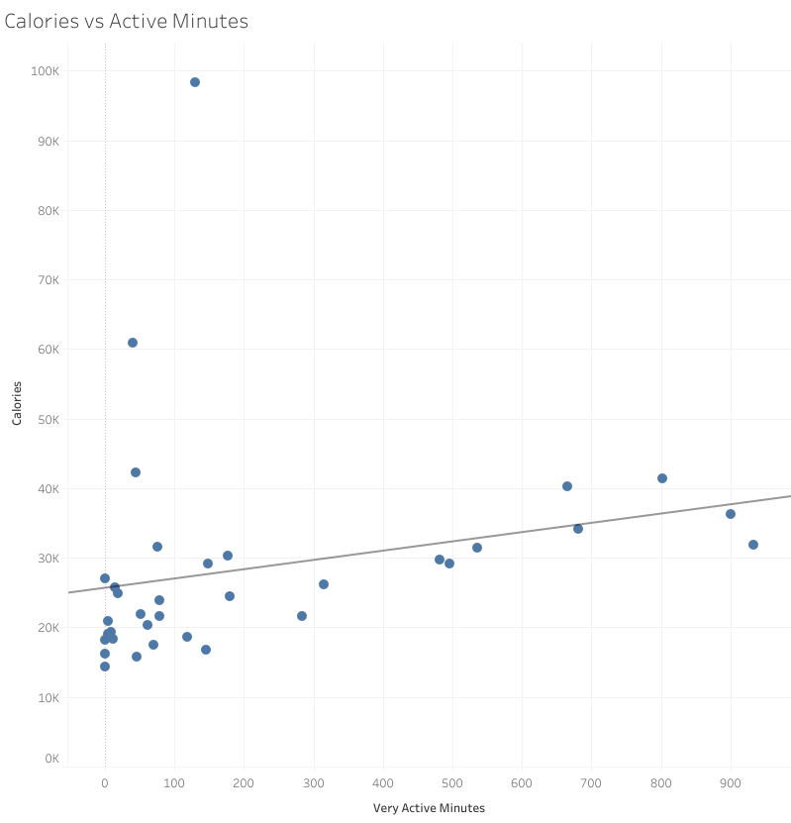
Activity patterns, intensity distribution, and calorie output reveal clear opportunities for optimizing daily movement and overall health.

Slide 13
RECOMMENDATIONS
1. Introduce Personalized Daily Step Goals
Use each user’s baseline activity to generate achievable, adaptive goals that gradually increase toward healthier movement patterns.
2. Implement Smart Activity Nudges
Deliver context‑aware reminders (time‑of‑day, inactivity duration, weekday patterns) to encourage movement during low‑activity periods.
3. Launch Habit‑Building Features
Incorporate streaks, badges, and weekly challenges to reinforce consistent movement and increase user engagement.
4. Highlight Mid‑Week Momentum
Leverage Wednesday’s natural activity peak by promoting mid‑week challenges or motivational prompts to amplify existing behavior patterns.

Slide 14
ACT — NEXT STEPS
1. Implement Personalized Goal Logic
Begin development of adaptive daily step goals based on each user’s baseline activity. This creates the foundation for habit‑building and future engagement features.
2. Deploy Smart Nudge Framework
Design and test context‑aware reminders triggered by inactivity patterns, time‑of‑day, and weekday behavior. This directly addresses the low‑movement finding
3. Build Engagement Layer (Streaks, Badges, Challenges)
Introduce lightweight gamification to reinforce consistent movement and capitalize on mid‑week momentum.
4. Validate Impact Through A/B Testing
Run controlled experiments to measure changes in daily steps, app engagement, and retention after feature rollout.

Slide 15
THANK YOU
Ruben Andujo
randujo2742@gmail.com

